Slide 1
Module 6

Slide 2


























Common Charts
Data Views
Hierarchies
Data Structures
Basic Navigation
Dashboards
You are here
Data Stories
Calculations
Advanced
Charts
Certification Springs
Blending
Done

Slide 3
Module 6 Learning Outcomes
Understand the joys of hiding data
Change settings with the Marks card
Demonstrate creating an alias
Know the secrets of copying format

Slide 4
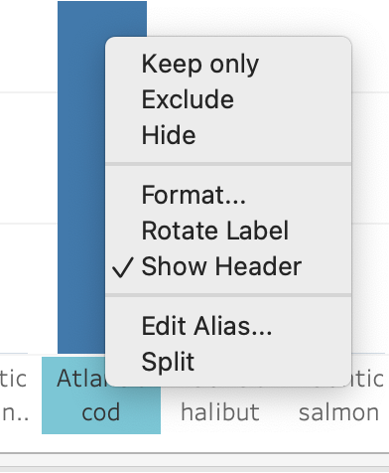
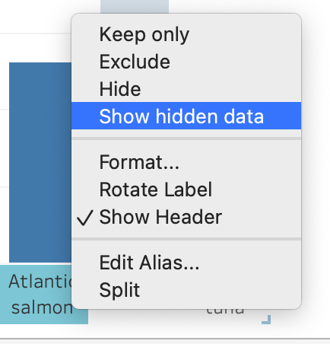
Hiding Data
Right click on any data to ‘hide’ it
You can get the data back by right
clicking on the axis and choosing “show hidden data”

Slide 5
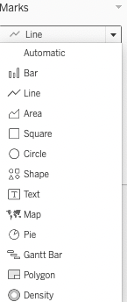
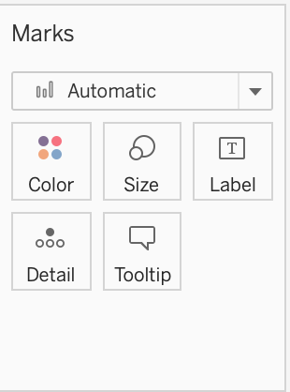
Marks Card
The main selector allows you to choose your chart type

Slide 6
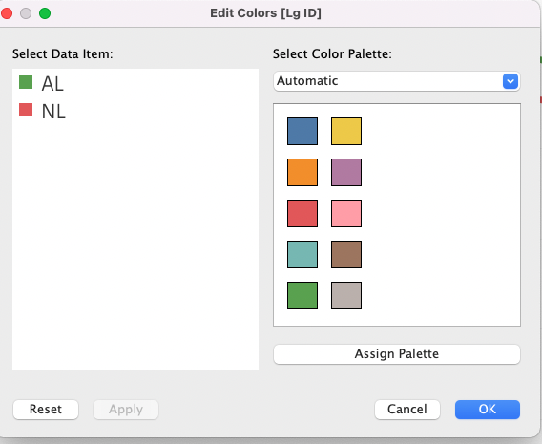
Marks: Color

Slide 7
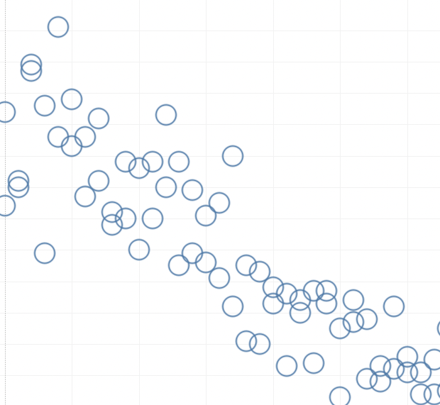
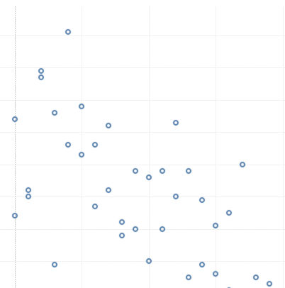
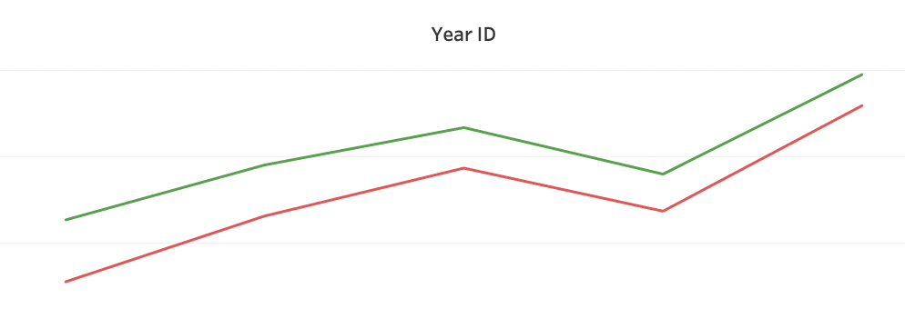
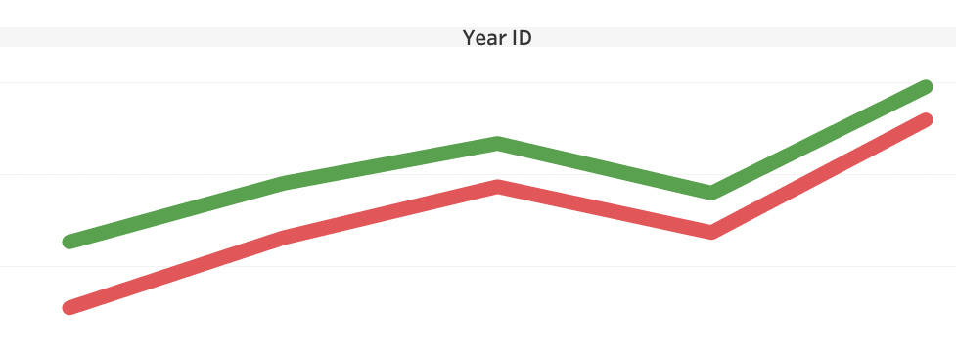
Marks: Size

Slide 8
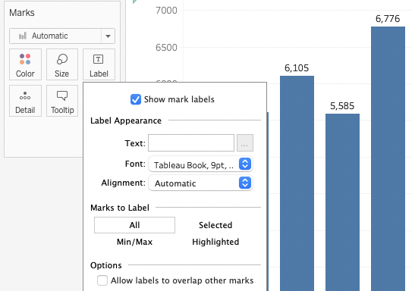
Marks: Label
Data Labels can be applied to all, highlighted or selected items

Slide 9
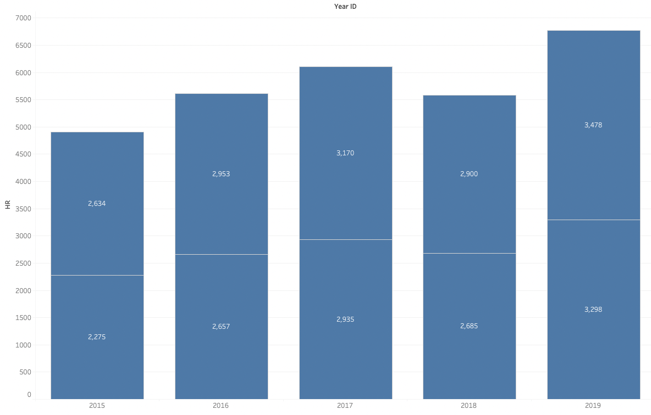
Marks: Detail

Slide 10
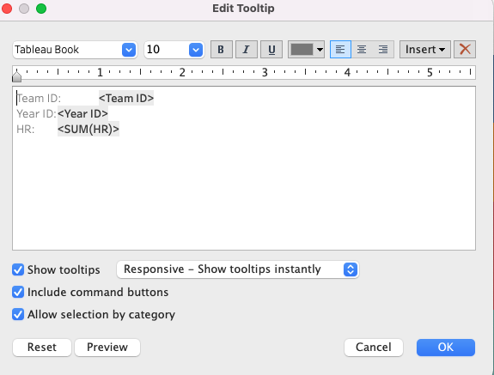
Marks: Tooltips
you can edit the automatic tool tip
by specifying data to include or exclude

Slide 11
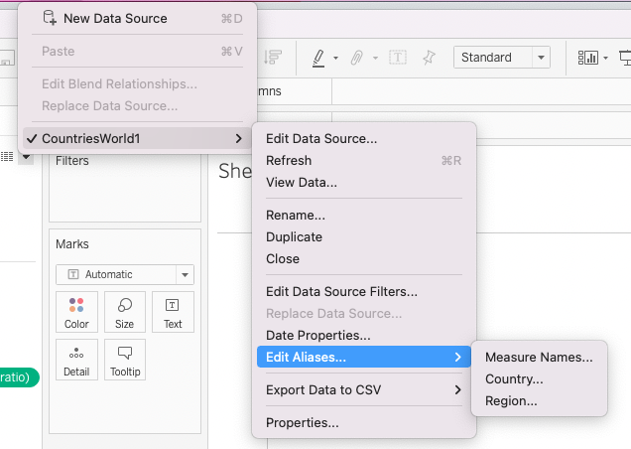
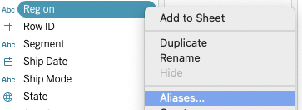
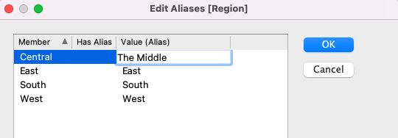
Aliases
Aliases allow you to map
new names onto existing
measures or dimensions

Slide 12
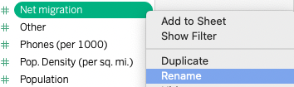
Duplicating and Renaming
You can duplicate and/or rename a dimension or measure

Slide 13
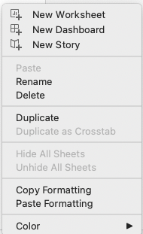
Copy Formatting
If you want to preserve formatting you can copy formatting to a new worksheet

Slide 14
Challenge
Use HollyWoodsMostProfitableStories.csv
Make a bar chart of ‘genre’ vs. SUM of ‘Worldwide Gross’
Change the y-axis to format currency, no decimals
Change the bar color to red
Reduce the bars to 50% size (slightly narrower than default)
Add labels to the bars and make them currency, no decimals, and 12pt black
Name the worksheet Genre
Add a new sheet and create a bar chart of ‘lead studio’ vs. SUM of ‘Worldwide Gross’
Copy formatting from your first worksheet and copy the formatting to your new worksheet
Create a tooltip and add the Genre worksheet so that you get an embedded viz in your tooltip

